Slide 1
By
K PAVAN KUMAR
Dept. Of CSE
VFSTR University

Slide 2
Top-Down Parser

Slide 3
Top-Down Parser
Constructing the parse tree which starts from the root and goes down to the leaf.
Find a left-most derivation of the input string.
Easy to implement.
Not all context-free grammars are suitable.
2 types i. With backtracking
ii. Without Backtracking

Slide 4
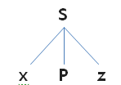


T-D-P with Backtracking
Expansion start from START symbol
Compare with input string.
If any mismatch occurs it goes with alternatives.
Grammar G: S→xPz , P→yw|y and input string “xyz”.

Slide 5

Ex: Consider the grammar
S→cAd, A→ab|a and parsing the string w=“cad”.
Ans: Consider the start symbol S.

Slide 6
T-D-P without Backtracking
1. Récursive Descente Parser (RDP)
2. Prédictive Parser / LL(1) parsers

Slide 7
Recursive Descent Parser
Uses collection of recursive procedures for parsing the given input string is called Recursive Descent Parser (RDP).
This parsing method may involve backtracking, that is, making repeated scans of the input.

Slide 8
Algorithm:
The RHS of the rule is directly converted into program code symbol by symbol.
If the input symbol is non-terminal then a call to the procedure.
If the input symbol is terminal then it is matched with the look-ahead from input.
If the production rule has many alternates then all has to be combined into a single body.
The parser should be activated by a procedure corresponding to the start symbol.

Slide 9
Consider the following grammar
E→E+T | T, T→T*F | F,F→(E) | id
Write down procedures for non-terminals of the grammar to make a RDP.
Ans:Given G is in left-recursive grammar can cause a recursive- descent parser to go into an infinite loop.
Hence,
Elimination of left-recursion must be done before parsing. So after removing the G becomes
E –> T E’
E’ –> + T E’ | ϵ
T –> F T’
T’ –> * F T’ | ϵ
F –> ( E ) | id

Slide 10
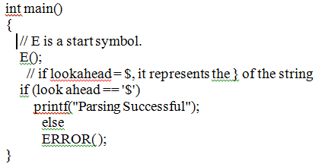
Recursive procedure:

Slide 11
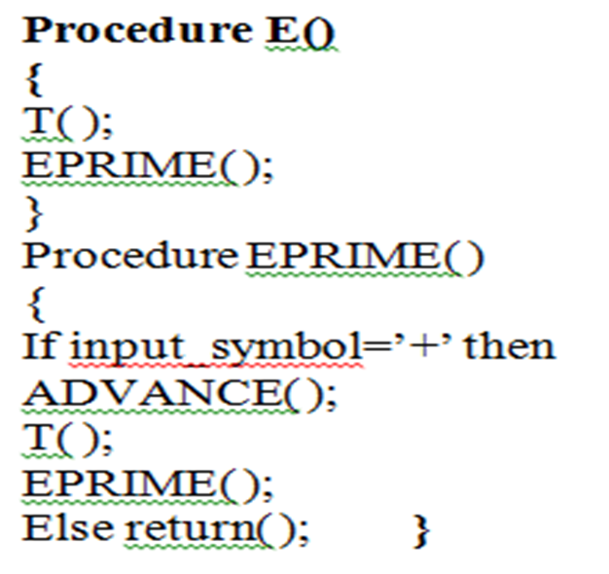
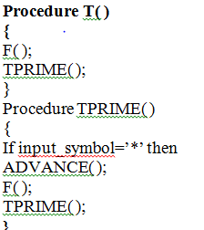
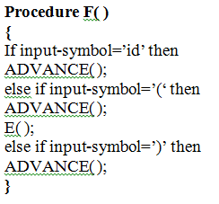

Slide 12
Stack implementation
PROCEDURE INPUT STRING
E( ) id+id*id
T( ) id+id*id
F( ) id+id*id
ADVANCE( ) id+id*id
TPRIME( ) id+id*id
EPRIME( ) id+id*id
ADVANCE( ) id+id*id

Slide 13
T( ) id+id*id
F( ) id+id*id
ADVANCE( ) id+id*id
TPRIME( ) id+id*id
ADVANCE( ) id+id*id
F( ) id+id*id
ADVANCE( ) id+id*id
TPRIME( ) id+id*id

Slide 14
Advantages of RDP:
Simple to build.
Disadvantages of RDP:
Not very efficient as compared to other parsing methods.
RD parser may enter in to infinite loop for some input or G.
Can not provide good error messaging.
It is difficult to parse the string if lookahead symbol is arbitrarily long.

